Slide 1
Perceptual Classification in a Rapidly Changing Environment
Author
Christopher Summerfield,
Timothy E. Behrens
Etienne Koechlin
Reporter
Xiaokai Xia

Slide 2
Abstract
Different models performance better in different environment

Slide 3
Abstract
Topic
We know how to learn to classify perceptual information if the environment stable over hundreds of trials
We don’t know categorization when the environment changes rapidly (jump unpredictable)
Method
fMRI
Computational modeling
optimal learning
cognitive strategy

Slide 4
Abstract
Results
Both model can explain unique variance in
Choice
Reaction time
Brain activity
Different models performance better in different environments
WM model → Volatile
Bayesian model → Stable
Different models predicted brain activity in distinct regions
Conclusion
perceptual category may be guided by multiple controllers

Slide 5
Introduction
Which strategy do we choose when we classify something

Slide 6
Introduction
Background
Fundamental question
An internal model of the environment¹
Simpler mechanisms²
Daw et al., 2005
Sutton and Barto, 1998

Slide 7
Introduction
If person making decision rely on a model
Decision making is demanding when the environment
change rapidly
without warning
An agent encodes higher-order statistical information
the transitional probabilities (Green et al., 2010)
variability (Preuschoff et al., 2008)
rates of change (Behrens et al., 2007)
Recent research map the neural structures that represent the changing value of states and stimuli
vmPFC (Hampton et al., 2006)
midbrain or insular cortex (chultz et al., 2008)

Slide 8
Introduction
If person making decision rely on a model
human voluntary choices are
fundamentally rational
can be described in a probabilistic framework

Slide 9
Introduction
Improvement — Experiment Design
Much of this research employ economic tasks¹
stimuli are typically simple discriminable
the choice value is uncertain
typically allowed many hundreds of training trials to learn information
stable
predictable
outside of the laboratory
deal with uncertainty pertaining to the categories
unpredictable, fast-changing environments
distinguish noise or changing
new learning quickly becomes outdated
Behrens et al., 2007; Boorman et al., 2009; Daw et al., 2006; Green et al., 2010; Hampton et al., 2006

Slide 10
Introduction
Improvement — Analysis Method
Recent neuroscientific research perceptual classification in humans by mimic them as a rational agent
encodes not only the category mean
also the category variability²
Model-based learning
Useful: distinguish optimally between outliers or events
Useless: limited precision and expensive to compute
Behrens et al., 2007; Boorman et al., 2009; Daw et al., 2006; Green et al., 2010; Hampton et al., 2006
Stocker and Simoncelli, 2006; Ashby and Gott, 1988; Michel and Jacobs, 2008; Anderson, 1991

Slide 11
Introduction
Improvement — Analysis Method
Recent neuroscientific research perceptual classification in humans by mimic them as a rational agent
encodes not only the category mean
also the category variability²
Model-based learning
Useful: distinguish optimally between outliers or events
Useless: limited precision and expensive to compute
Working memory learning
maintain the most recent information about each category
Behrens et al., 2007; Boorman et al., 2009; Daw et al., 2006; Green et al., 2010; Hampton et al., 2006
Stocker and Simoncelli, 2006; Ashby and Gott, 1988; Michel and Jacobs, 2008; Anderson, 1991

Slide 12
Introduction
Method
Design:
classify sequentially occurring stimuli (oriented gratings)
Categories’ mean and variability changed unpredictably
Using three models to contrast
Behavior
fMRI
Models
Bayesian model (model-based optimal estimation)
Q-learning (model-free habit learning)
Working Memory model (short-term maintenance)

Slide 13
Introduction
Brief result
Both model encoded unique variance overall data
participants use a mixture of model-based strategies
Participants’ tendency to use a decision policy depended on the volatility of the environment
Bayesian model ← Stable
WM model ← Volatile
different strategies were associated with different brain activity
Bayes: striatum and medial prefrontal cortex (PFC)
WM: visual regions, and the dorsal frontal and parietal cortex
Notes:
贝叶斯：纹状体，内测前恶业
WM： 背侧额叶和顶叶

Slide 14
Methods
Experiment / Model / Analysis

Slide 15
Subjects
20 healthy members
Aged between 18-37 years old
Excluded
People with poor vision
People with psychiatric or neurological disorder
Paid 80 euros

Slide 16
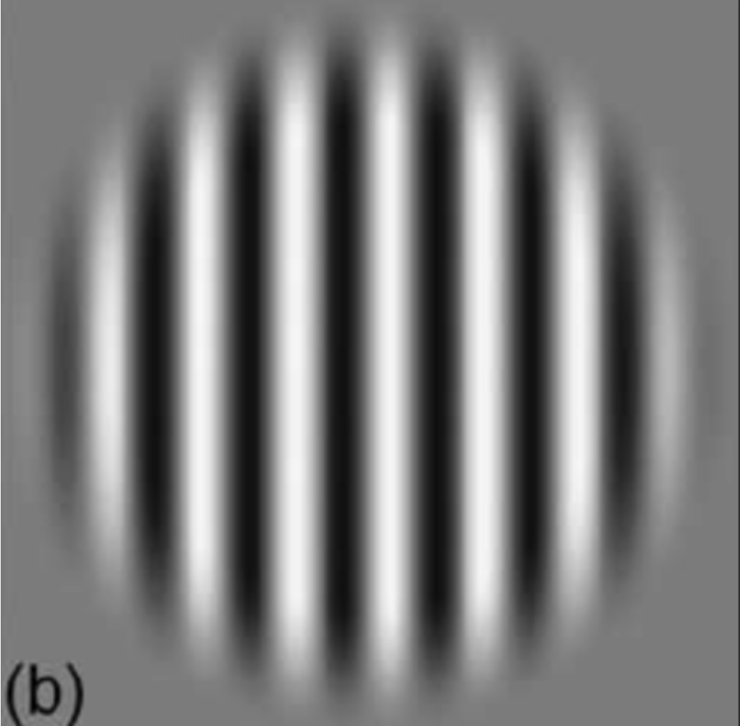
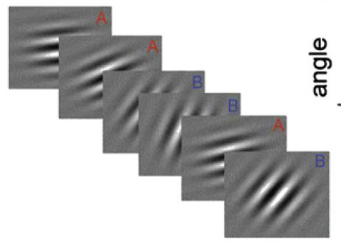
Experiment design
Stimuli
full-contrast Gabor patches
oriented at between -90° and 90° relative to the vertical meridian
Auditory feedback
ascending (400/800 Hz)
descending (800/400 Hz)

Slide 17
Experiment Design
Procedure
5 scanning sessions of 8 min each, 120 successive trials
Each trial
stimulus was visible for 1500 ms (with ake a categorization judgment)
Auditory feedback 200 ms
interval in the range of 3–7 s followed stimulus onset
25% of trials correct or incorrect feedback engendered a small monetary gain or loss
Category means and variances
unstable and independent
jumped unpredictably every 10 or 20 trials

Slide 18
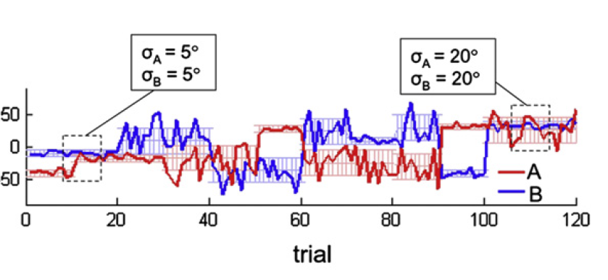
Experiment Design
Procedure

Slide 20
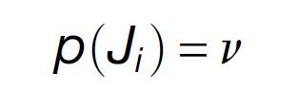
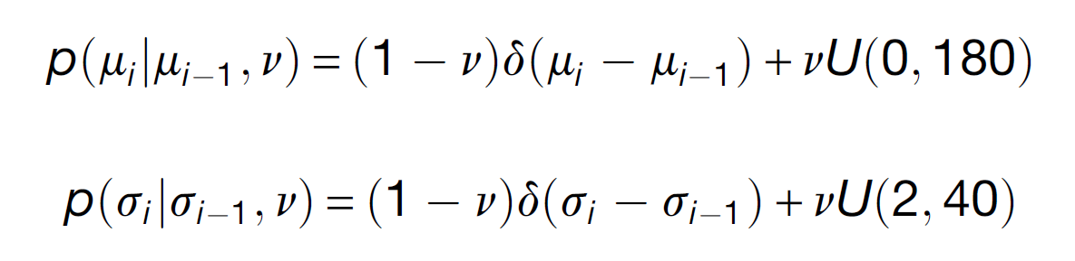
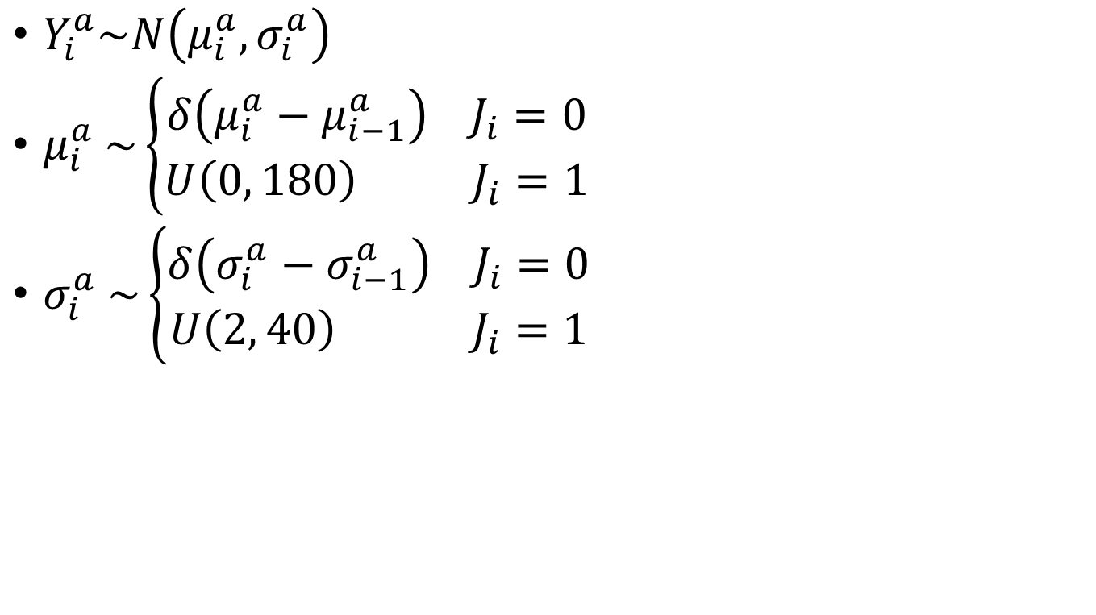
Models
Bayesian model
$Y_{i}^{a}\sim N\left(μ_{i}^{a},σ_{i}^{a}\right)$
$μ_{i}^{a} \sim \left\{\begin{aligned}δ\left(μ_{i}^{a}−μ_{i−1}^{a}\right) J_{i}=0 \\ U\left(0, 180\right) J_{i}=1\end{aligned}\right.$
$σ_{i}^{a} \sim \left\{\begin{aligned}δ\left(σ_{i}^{a}−σ_{i−1}^{a}\right) J_{i}=0 \\ U\left(2, 40\right) J_{i}=1\end{aligned}\right.$

Slide 21
Models
Bayesian model
$Y_{i}^{a}\sim N\left(μ_{i}^{a},σ_{i}^{a}\right)$
$μ_{i}^{a} \sim \left\{\begin{aligned}δ\left(μ_{i}^{a}−μ_{i−1}^{a}\right) J_{i}=0 \\ U\left(0, 180\right) J_{i}=1\end{aligned}\right.$
$σ_{i}^{a} \sim \left\{\begin{aligned}δ\left(σ_{i}^{a}−σ_{i−1}^{a}\right) J_{i}=0 \\ U\left(2, 40\right) J_{i}=1\end{aligned}\right.$

Slide 22
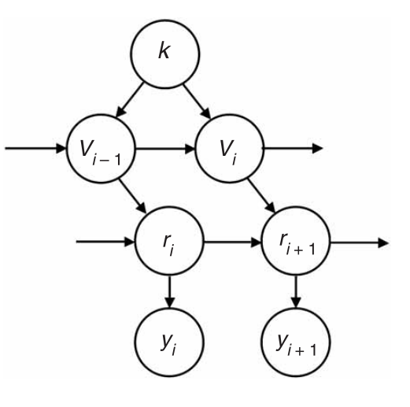
Models
Bayesian model
$Y_{i}^{a}\sim N\left(μ_{i}^{a},σ_{i}^{a}\right)$
$μ_{i}^{a} \sim \left\{\begin{aligned}δ\left(μ_{i}^{a}−μ_{i−1}^{a}\right) J_{i}=0 \\ U\left(0, 180\right) J_{i}=1\end{aligned}\right.$
$σ_{i}^{a} \sim \left\{\begin{aligned}δ\left(σ_{i}^{a}−σ_{i−1}^{a}\right) J_{i}=0 \\ U\left(2, 40\right) J_{i}=1\end{aligned}\right.$

Slide 23
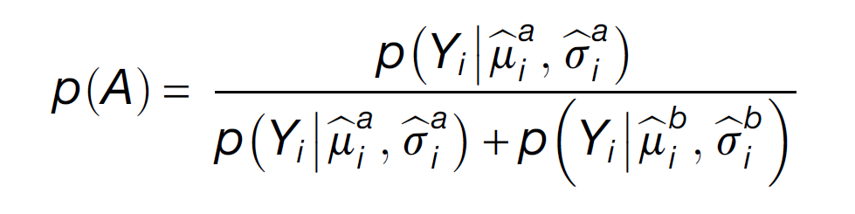
Models
Bayesian model
$Y_{i}^{a}\sim N\left(μ_{i}^{a},σ_{i}^{a}\right)$
$μ_{i}^{a} \sim \left\{\begin{aligned}δ\left(μ_{i}^{a}−μ_{i−1}^{a}\right) J_{i}=0 \\ U\left(0, 180\right) J_{i}=1\end{aligned}\right.$
$σ_{i}^{a} \sim \left\{\begin{aligned}δ\left(σ_{i}^{a}−σ_{i−1}^{a}\right) J_{i}=0 \\ U\left(2, 40\right) J_{i}=1\end{aligned}\right.$

Slide 24
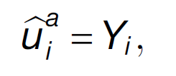
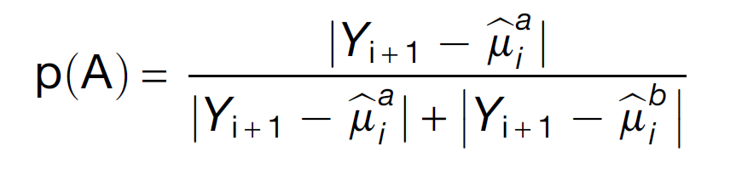
Model
WM Model
Feedback indicated that a stimulus Y is from the category A
The WM model updated the category information using a delta rule with a learning rate of 1

Slide 25
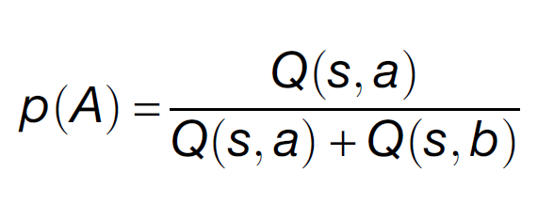
Model
Q-learning Model
R is the feedback (correct = 1; incorrect = 0)

Slide 26
Result
Behavior & fMRI

Slide 27
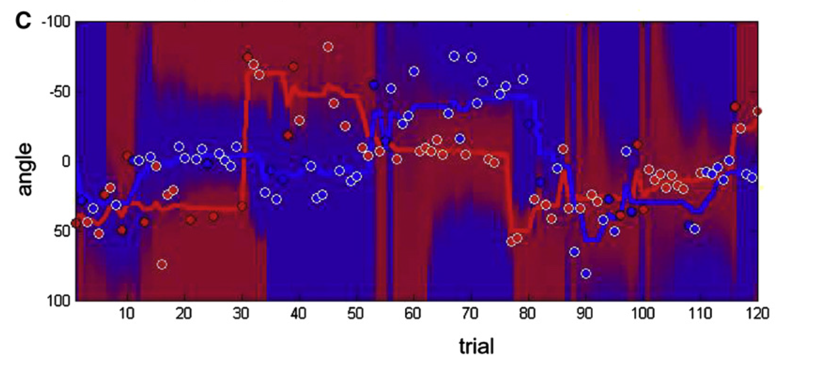
Result on behavior
Overall
Responding correctly on 68.6% ± 3.9% of trials
Mean RTs of 697 ± 131 ms
Failed to respond within the deadline on an average of 9.6 ± 4.1 (range 5–22) trials

Slide 28
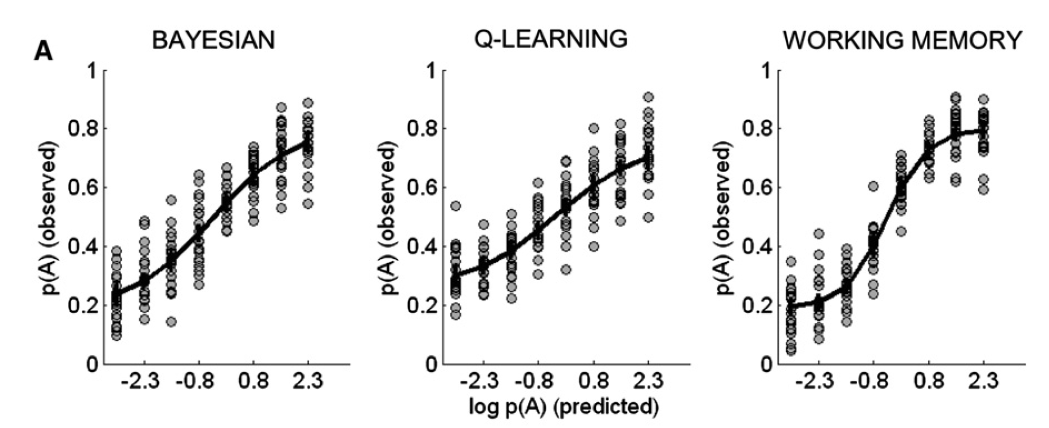
Result on behavior
Predicting Choice
Method
Estimate choice values p(A) under each model for successive stimuli in the trial sequence
Trials were sorted into bins according to their value of p(A)
observed mean choice probability was calculated for each bin

Slide 29
Result on behavior
Predicting Choice
Method
Estimate choice values p(A) under each model for successive stimuli in the trial sequence
Trials were sorted into bins according to their value of p(A)
observed mean choice probability was calculated for each bin

Slide 30
Result on behavior
Predicting Choice
multiple regression
Each explained some unique variance in choice behavior
Bayesian model: t₍₁₉₎ = 8.77, p < 1 × 10⁻⁷
WM model: t₍₁₉₎ = 16.6, p < 1 × 10⁻¹²
QL model: t₍₁₉₎ = 2.4, p < 0.02

Slide 31
Result on behavior
Predicting Choice
multiple regression
Each explained some unique variance in choice behavior
Bayesian model: t₍₁₉₎ = 8.77, p < 1 × 10⁻⁷
WM model: t₍₁₉₎ = 16.6, p < 1 × 10⁻¹²
QL model: t₍₁₉₎ = 2.4, p < 0.02

Slide 32
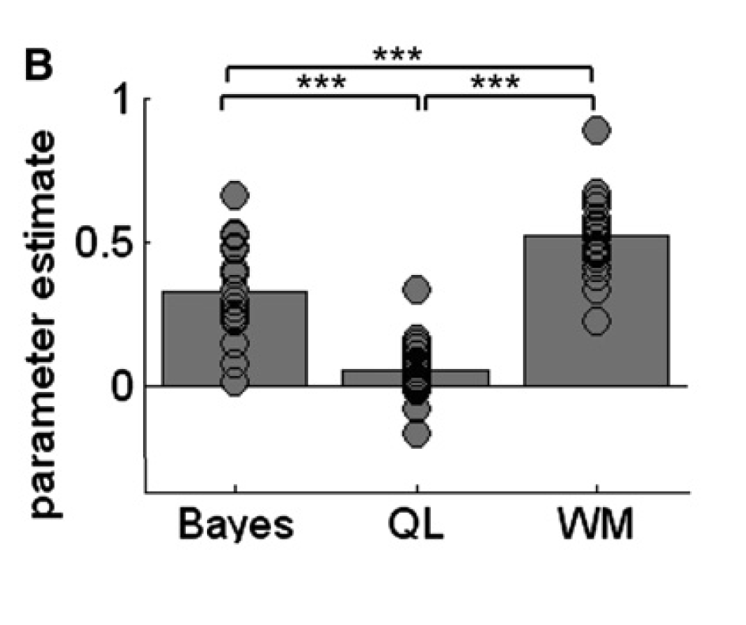
Result on behavior
Predicting Choice
multiple regression

Slide 33
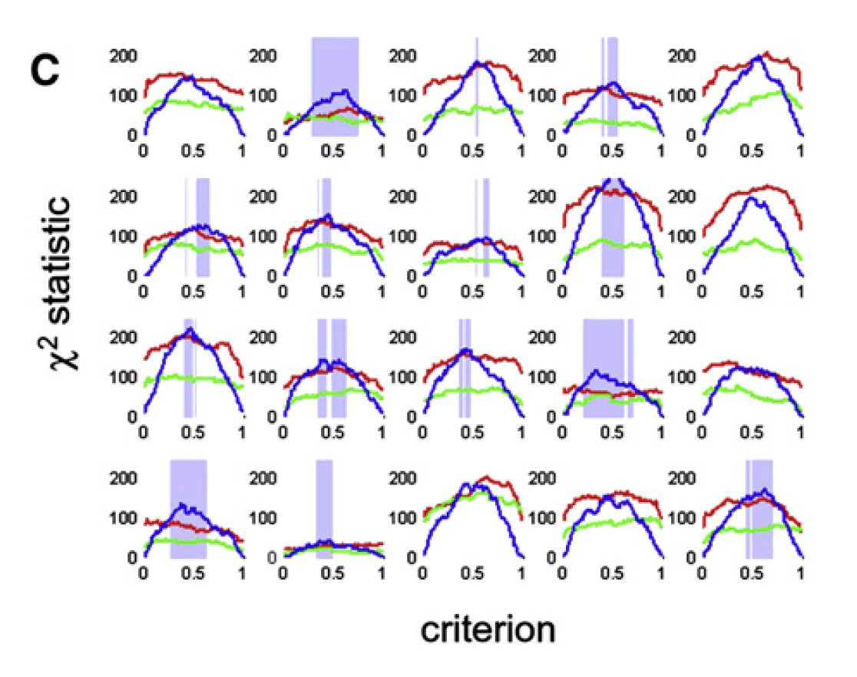
Result on behavior
Predicting Choice
Choose criterion c (model choices to human) choices

Slide 34
Result on behavior
If people can learn the jump
Method
Calculate the learning rate (delta rule)
Different between first 8 trials to 9-13 following switch
compared learning rates for different phases of a 10 trials (e.g 3–7, 13–17, versus trials 1–2, 8–12)

Slide 35
Result on behavior
If people can learn the jump
Different between first 8 trials to 9-13 following switch
Participants learned faster immediately following a switch (t(19) = 3.15; p < 0.004)
WM can capture but Bayes cannot
compared learning rates for different phases of a 10 trials(e.g. 3–7, 13–17, versus trials 1–2, 8–12)
almost identical learning rates (0.73 versus 0.69, t₍₁₉₎ < 1)
If participants explicitly using knowledge they will learn faster in a period where jumps were more probable

Slide 36
Result on behavior
If people can learn the jump
Participants do not learn the periodic structure of the task
The Bayesian model is not unfairly disadvantaged by being blind to the 10–20 trial jump cycle

Slide 37
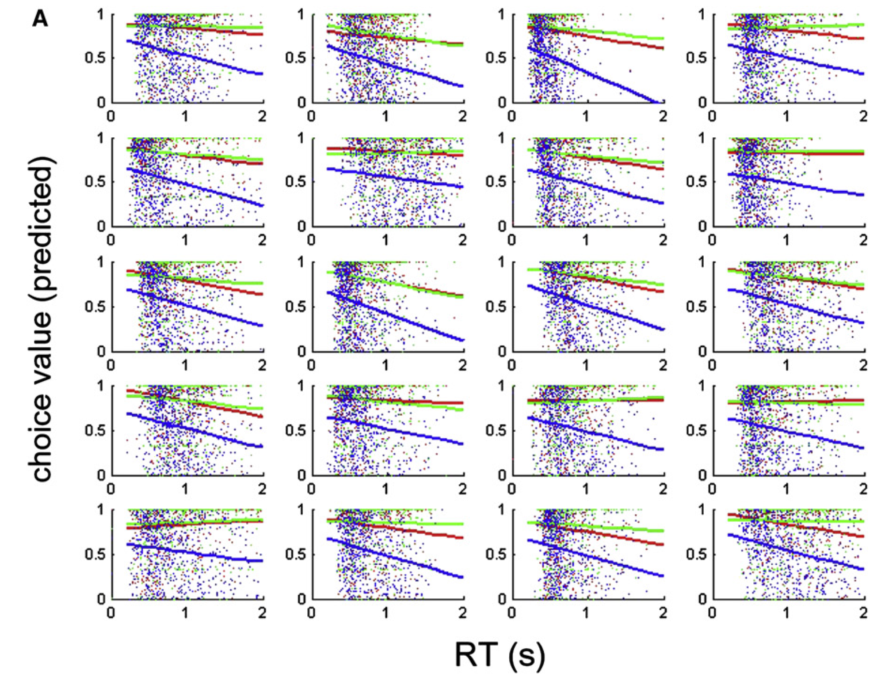
Result on behavior
Predicting RT
Bayesian (red)
QL (green)
WM (blue)
Bayesian: p < 1×10⁻⁹
QL: p < 0.48
WM: p < 1×10⁻¹²

Slide 38
Result on behavior
Correlation with Volatility
Assume:
Working memory strategy > higher-order model-based strategies might depend on the volatility environment
People using variance information when environment stable (more available computational resource)
probabilistic information is most useful in volatility environment
Method: correlation between error estimated by model and volatility
Bayesian: t < 0.003
QL: t < 0.02
WM: t = 0.58

Slide 39
Result on behavior
Correlation with Volatility
Assume:
Working memory strategy > higher-order model-based strategies might depend on the volatility environment
People using variance information when environment stable (more available computational resource)
probabilistic information is most useful in volatility environment
Method: correlation between error estimated by model and volatility
Bayesian: t < 0.003
QL: t < 0.02
WM: t = 0.58
Better when stable

Slide 40
Result on behavior
Correlation with Volatility
For WM model
Separate the trials for 25% most volatile and 25% least volatile trials
Most volatile: p < 0.001
Least volatile: p = 0.34

Slide 41
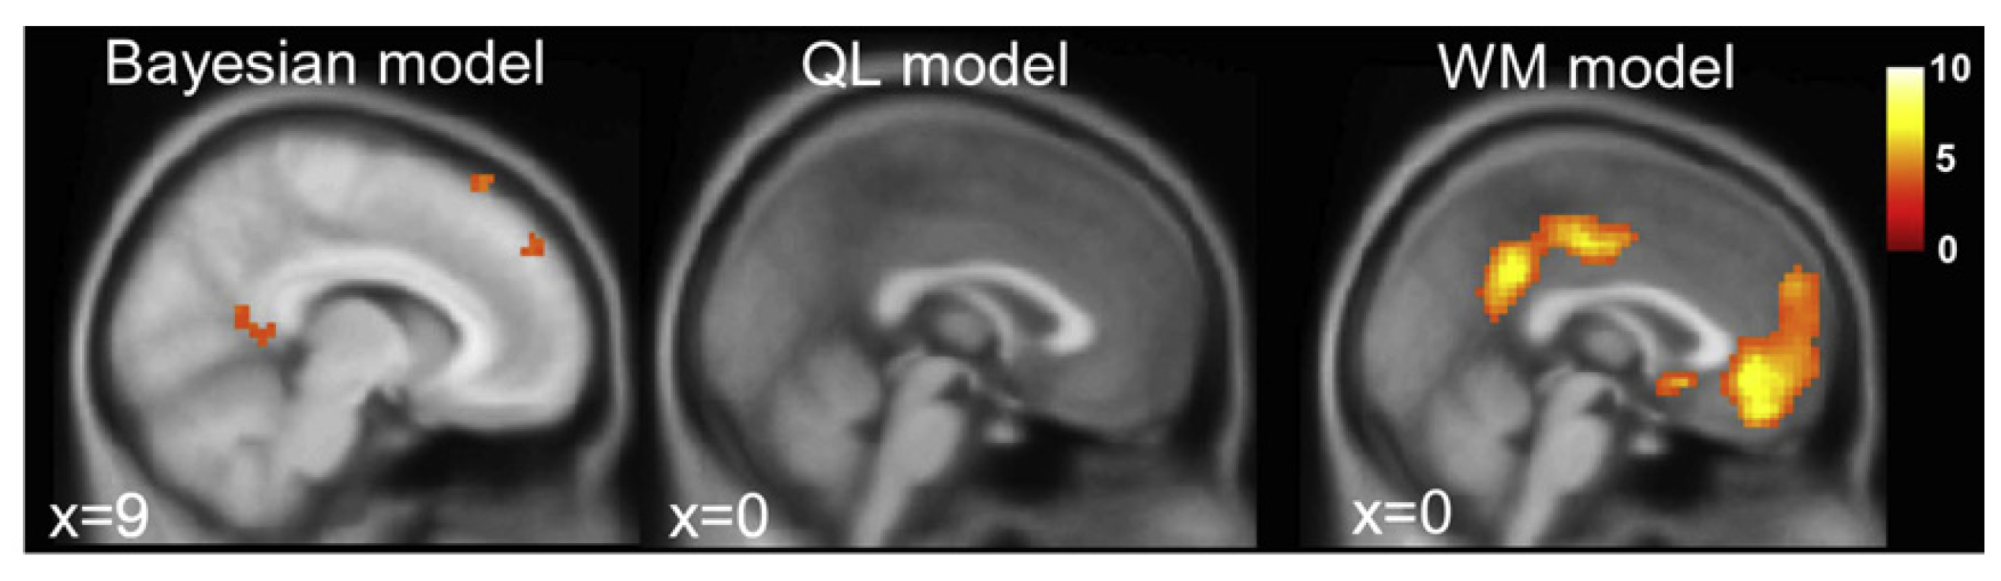
Result on fMRI
Expected Value
Generate trial-by-trial predictions by modeling in single design matrix
Reflect the unique contribution of each model
to fMRI signals

Slide 42
Result on fMRI
Decision Entropy
Decision Entropy: how close the probability of choosing A over B was to chance

Slide 43
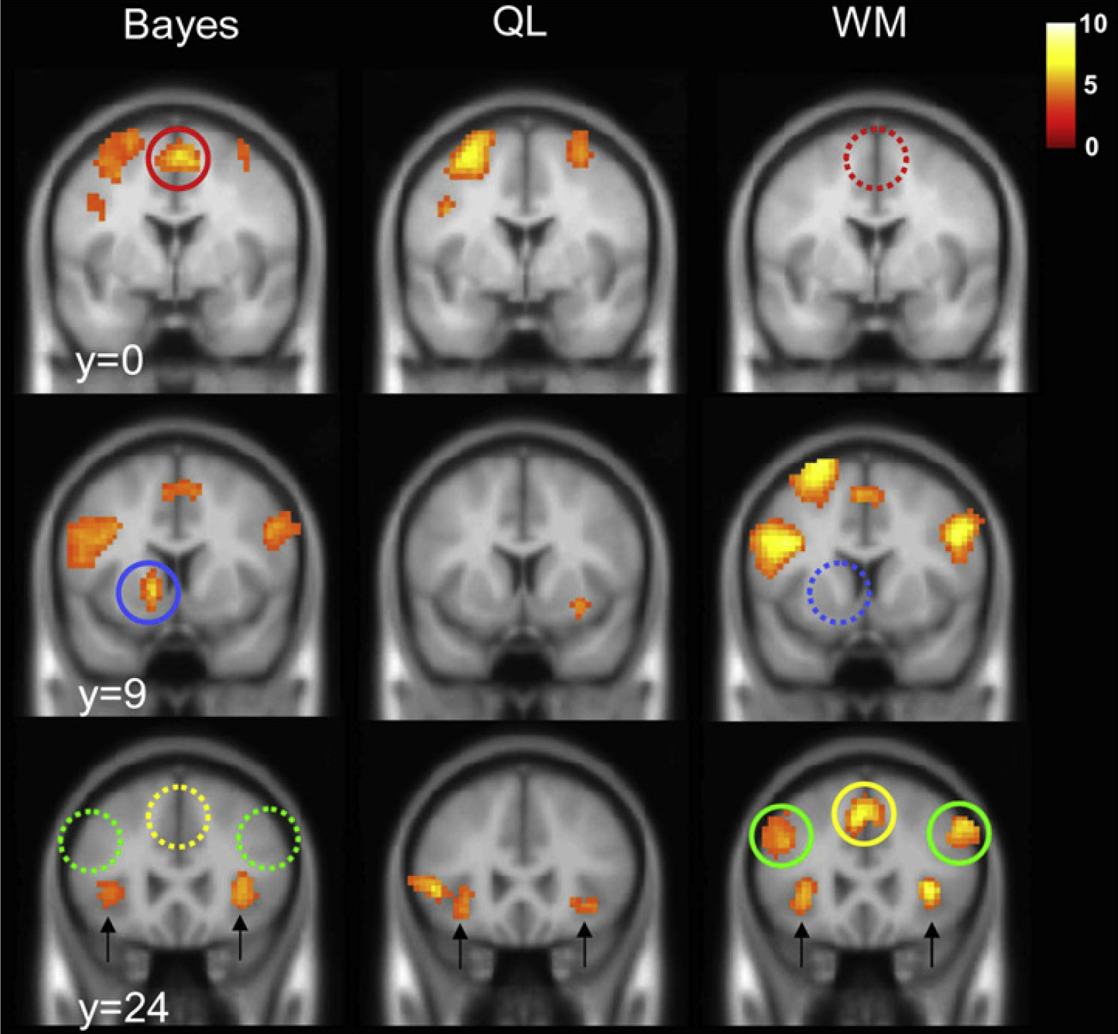
Result on fMRI
Decision Entropy - inverse contrast
red, SMA
blue, striatum
green, dlPFC
yellow, pre-SMA

Slide 44
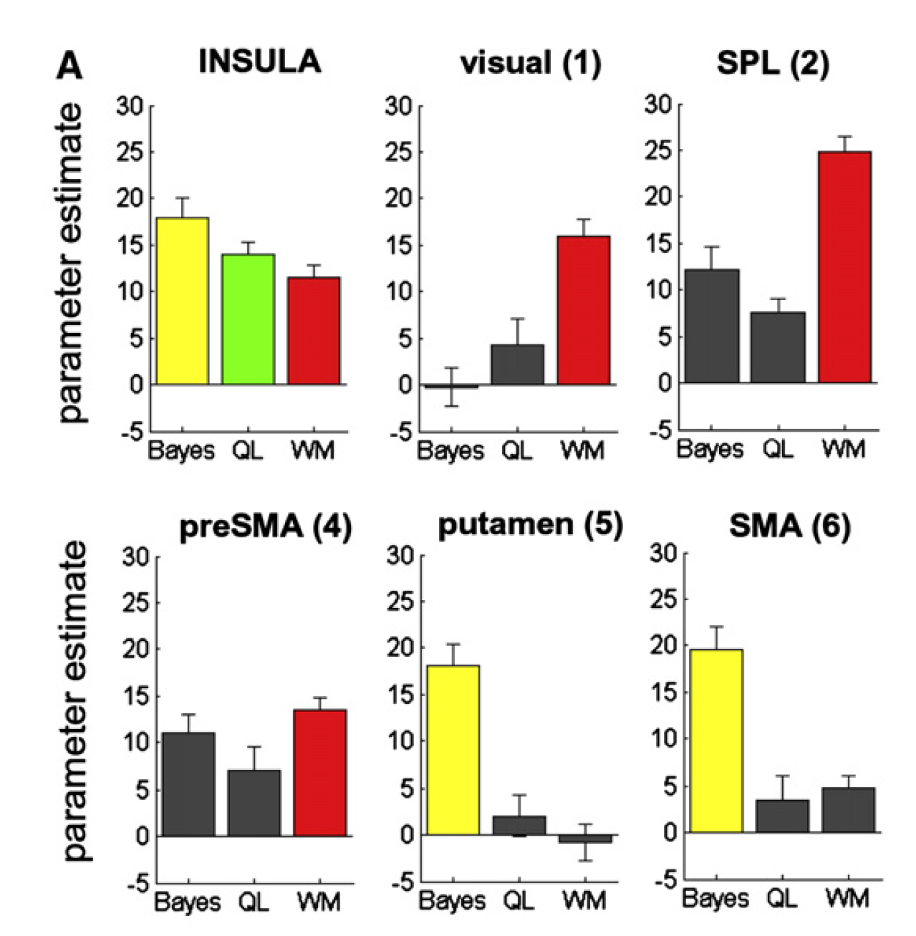
Result on fMRI
Decision Entropy - inverse contrast

Slide 45
Result on fMRI
Decision Entropy - inverse contrast
Anterior insular cortex were robustly predicted by all three models
WM model was mainly unique observed in
extrastriate visual cortex
dorsal frontoparietal
dlPFC
pre-SMA
Bayesian model unique active
left striatum
SMA
Notes:
背侧顶叶
SMA（辅助运动区）

Slide 46
Result on fMRI
fMRI Signals for Category Updating
Assume
Whether neural signals reflecting updating of information at the time of feedback are modulated by variance and volatility
Statistical decision strategy will revise this estimate more when category variance is low (Preuschoff and Bossaerts, 2007)
Regressor
Variable: variance under low, but not high, volatility

Slide 47
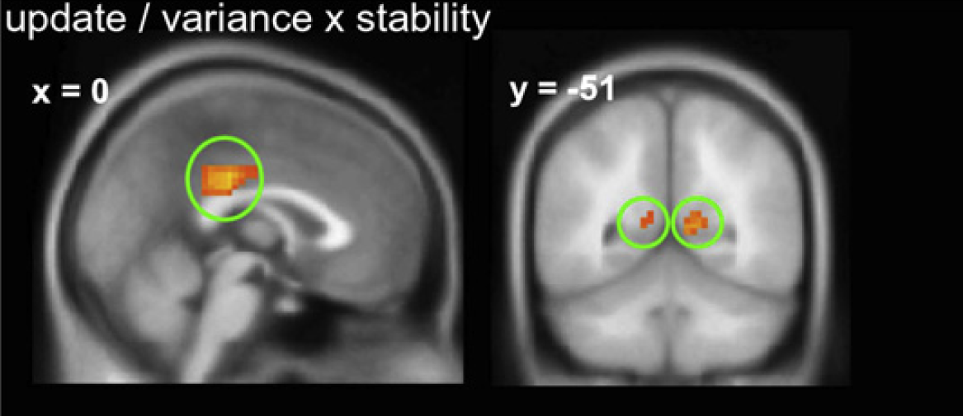
Result on fMRI
fMRI Signals for Category Updating
Result
posterior portion cingulate gyrus
extending into the posterior cingulate two sides
SMA
Notes:
前扣带回延伸到扣带回两侧

Slide 48
Discussion

Slide 49
Discussion
Finding
The simple, working memory model was the best predictor of choice, RT, and brain activity across the experiment
People may favor a fast and frugal categorization strategy
fMRI analyses also identified specific neural circuits associated with this simple, memory-based decision strategy
Other model still can explain unique variable on behavior and brain activity

Slide 50
Discussion
Incon
In our task, ‘‘stable’’ environments consisted of runs of 20–30 trials
A far shorter training interval than the hundreds or even thousands of trials offered in many categorization or sensorimotor tasks
Maybe leave the WM model a nice performance

Slide 51
Conclusion
Participants adapt their decision strategy to the demands of the environment
statistically optimal behavior ← stable
Rely on maintenance processes by the PFC ← volatile

